Slide 1
2023 Remote Sensing
Anand Gnanadesikan
Johns Hopkins University

Slide 2
Disclaimer
This presentation was prepared using draft rules.
There may be some changes in the final copy of the rules.
Final copies of the rules will be released on Tuesday, September 6, 2022 at soinc.org.
These rules will be the official rules for the 2023 Season.

Slide 3
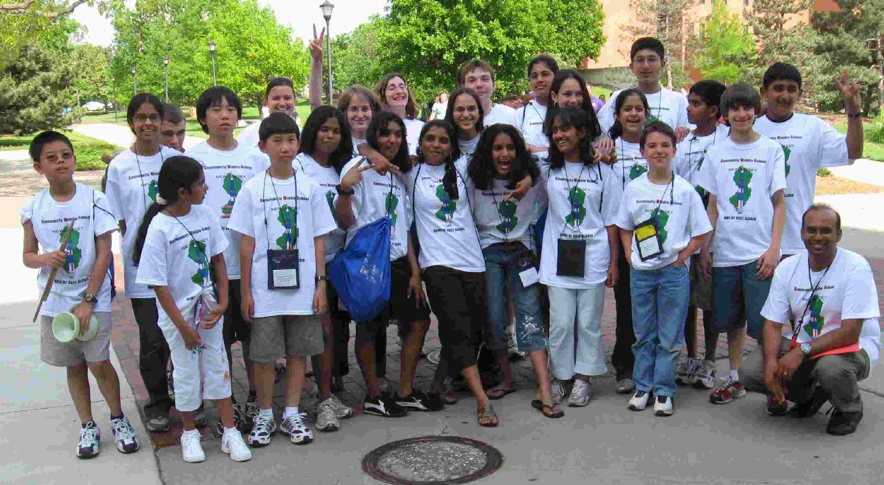
A little bit about me
Physical oceanographer by training. Have worked with remotely sensed products for ocean waves, ocean color, sea surface temperature, ice cover, aerosols.
Currently on the faculty at JHU in the Department of Earth and Planetary Sciences
SO parent-coach
Running events since 2004

Slide 4
What is event?
Remote sensing covers how we track climate from space.
Key points
  How does instrumentation work and what kinds of products are produced?
  Can you interpret output from instrumentation?
  Can you explain the key climate processes underlying climate change?
  Can you solve a simple energy balance model for earth?

Slide 5
Key skills
Read a plot with different axes (log-log, time series)
How to go from a contour plot to a line plot.
How to link what gets measured (radiances, time-of-flight) to what you are trying to measure (temperatures, sea level).
Solve simple algebraic equations

Slide 6

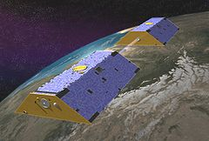
Types of sensors
Electromagnetic
  Active (shoot radiation at planet, look at return)
  Passive (use radiation coming off planet or scattered in atmosphere)
Gravitational
  Use changes in acceleration to get at distribution of mass.

Slide 7
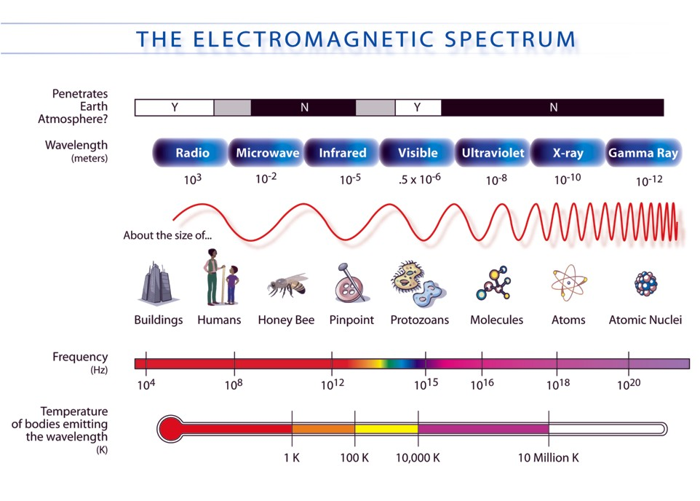
Key concept 1: Electromagnetic spectrum
Difference between microwave, IR, visible.
What it means to say that we sense things at different wavelengths.
How different wavelengths might be combined to learn about greenhouse gasses, vegetation, surface temperatures, ice.

Slide 8
Key concept 2- Black body radiation
Spectrum shows energy ) emitted at different wave lengths. Different colors show “black body” curves at different wavelengths.
This implies we can find “brightness” temperatures by looking at emitted radiation at different wavelengths.
Greenhouse gasses make atmosphere opaque in different wavelengths, so that what is seen from space is higher up and colder.
Q=εσT⁴
http://climatemodels.uchicago.edu/modtran/

Slide 9
Example using these curves
Questions:
How far down in the atmosphere can you see at a wavelength of 12 microns?
Source
http://climatemodels.uchicago.edu/modtran/

Slide 10
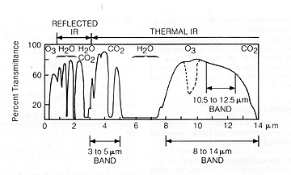
Key concept 3:Atmospheric absorption
Transparency of the atmosphere varies
How does this explain the greenhouse effect?
How might we detect concentration of a gas?

Slide 11
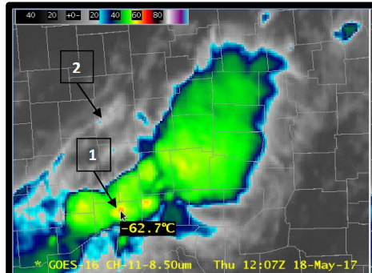
Example: GOES IR Band 11
Uses radiance in band centered at 8.5 microns to estimate temperature.
Band is relatively “clean” but sulfur dioxide can contaminate it.
Colors show decreasing temperature, increasing cloud height.
Deep convective towers potentially associated with intense thunderstorms.
https://www.star.nesdis.noaa.gov/GOES/documents/ABIQuickGuide_Band11.pdf

Slide 12
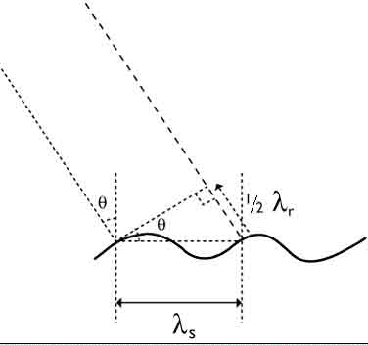
Key concept 4: Scatterometry
Many radars use the concept of Bragg scattering, which requires “resonance” between a scatterer and the wavelength of incoming radiation.
The intensity of the scattering tells you about the “roughness” of the surface at that wavelength.

Slide 13
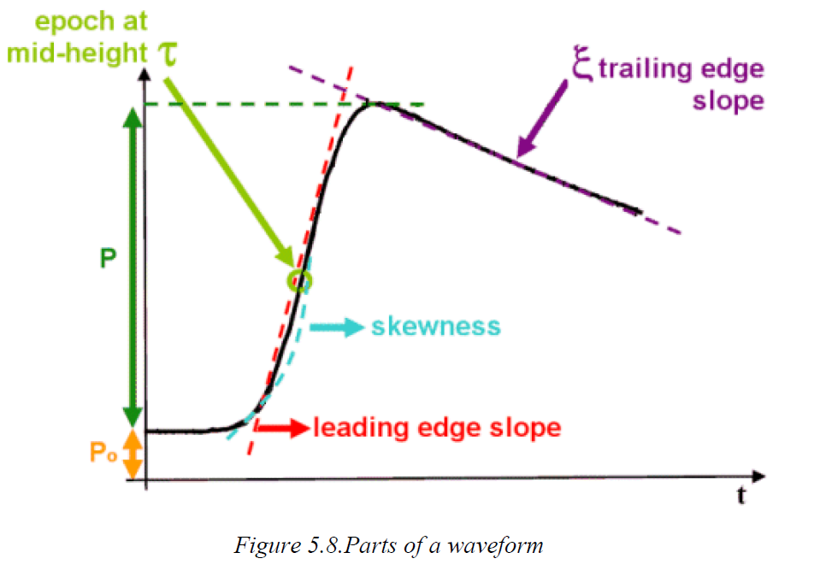
Resulting signal

Slide 14
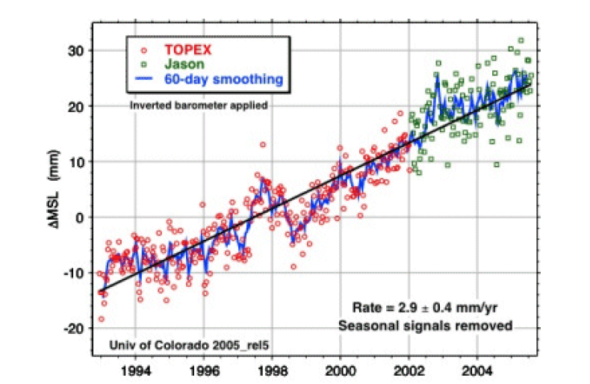
Example
How is this measured?
Why might tides be a problem?
What are the two dominant sources of the trend?
http://www.altimetry.info/ has lots of info on altimetry,
Includes a bunch of cases and images useful for testing.

Slide 15
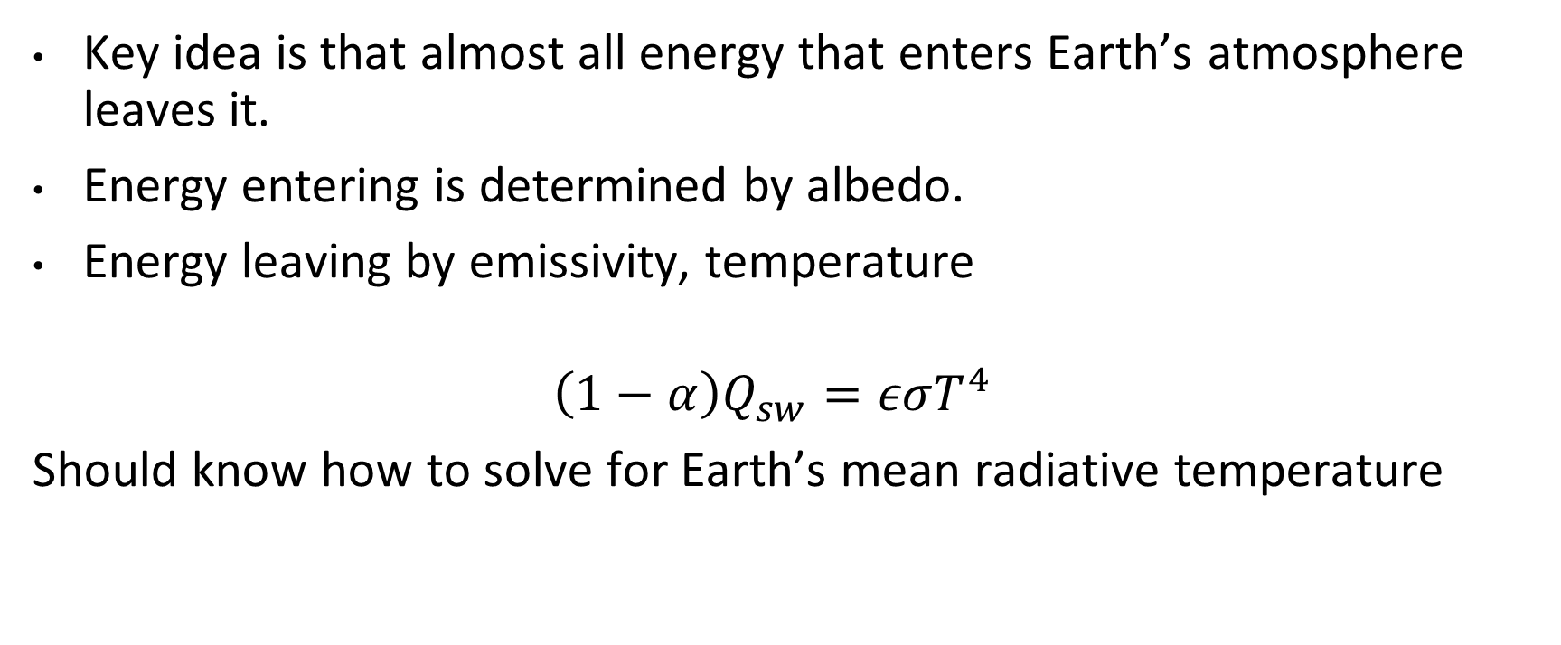
Key concept 5: Energy balance
Key idea is that almost all energy that enters Earth’s atmosphere leaves it.
Energy entering is determined by albedo.
Energy leaving by emissivity, temperature
$$\left(1−α\right)Q_{sw}=εσT^{4}$$
Should know how to solve for Earth’s mean radiative temperature

Slide 16
Key concept 6-Feedbacks and relationships
Positive relationship
  Increase in X (say temperature) causes increase in Y (say outgoing IR radiation)
Negative relationship
  Increase in X (say outgoing radiation) causes decrease in Y (say temperature)
Feedback loop
Temperature
Outgoing IR radication

Slide 17
Further resources
NASA mission pages often have nice descriptions of how specific instruments
https://ocov2.jpl.nasa.gov/science/measurement-approach
Laboratories that work on particular projects often have good web resources
https://www.star.nesdis.noaa.gov/socd/lsa/SeaLevelRise/
http://www.altimetry.info/
Professor David Archer’s webpage at the University of Chicago has some really useful models. (http://climatemodels.uchicago.edu/ )

Slide 18
Thoughts about coaching this event
Physics background really helpful.
Students who are independent learners are great…
… but you need to hold them accountable.
Having them make tests for each other is a good strategy.
GOOD LUCK AND THANKS FOR DOING THIS!

